Slide 1
ETL Implementation For Bicycle Ride Share System Provider
By,
Aditya K Kulthe
MES Institute Of Management And Career Courses, Pune.
Mca :- III Div :- B
Sem :- VI
Roll No :- 1912024
Seat No :- 15284
Date :- 22/09/2022

Slide 2
Quote’
“If you torture the data long enough, it will confess to anything.”
- British Economist Ronald Coase

Slide 3
Project Scope
Due exponential growth in a data now a day it is fuel for company to make data driven business decision. In this project I would like to implement ETL flow for bicycle ride share system provider company to make data driven business decision.
The current condition of the department of bicycle ride sharing systems provider in analyzing and processing its data is as follow:-
Each information system has its own data.
The data is in a flat file format (.csv), the data is scattered in each information system, redundancy in data is still occurring in the analysis and decision-making.
The executives of the bicycle ride sharing system provider had to do a recap of data from each information system for improving the performance of the company by providing the accurate and up to date data to generate strategic decisions.

Slide 4
The aim of bicycle ride share system provider is to be a significant player in its chosen markets.
Their expertise, service and execution skills will differentiate the strategic business unit (SBU) from its peers.
The project is required in order to help the decision makers of the company to make an EFFECTIVE DECISION.
Effective decisions are choices that move an organization closer to an agreed-on set of goals in a timely manner.
Effective decision making is important at all organizational levels. Timely Foundation And Feedback Information is needed as part of that effective decision-making. Therefore, we need to make business intelligence available throughout the organization.

Slide 5
Project Workflow
Extraction Phase :- In this phase of project I extracted sensor generated open source bicycle ride share (.csv files) data for five different cities in US like Chicago, New York , New Jersey City, Washington DC, Boston. Data is from year 2017 to 2020 store on AWS S3 bucket to the system for ETL purpose.
Transformation Phase :- In this phase of project I perform all data preprocessing and cleaning operations (Python panda library) on all extracted bicycle ride share data. Data preprocessing include handling missing & duplicate data also transforming data in proper format so it is useful for query and analysis purpose.
Load Phase :- In this phase of project I load all transformed data in relational database system(MySQL) . The data which load into relational database system is useful for company to make data driven business decision using KPI’s like

Slide 6
K P I – Key Performance Indicators
Popular times of travel :-
Most common month

Slide 7
K P I – Key Performance Indicators
Popular station :-
Most common start station

Slide 8
K P I – Key Performance Indicators
Trip duration :-
Popular trip duration.
User info :-
Counts of each user type
Counts of each gender

Slide 9
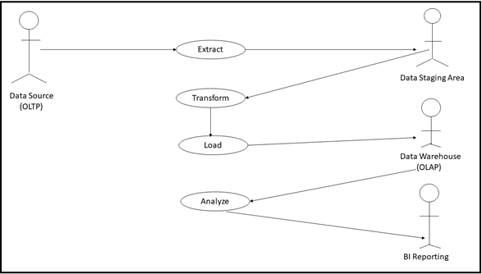
Use Case Diagram

Slide 10
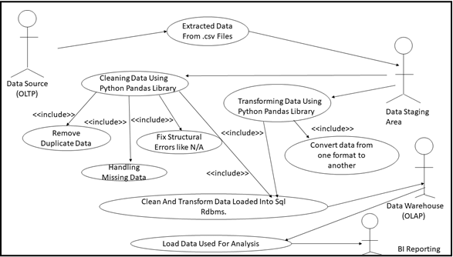
Business Use Case Diagram

Slide 11
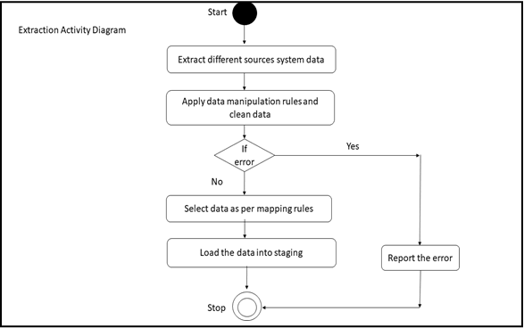
Activity Diagram (Extract)

Slide 12
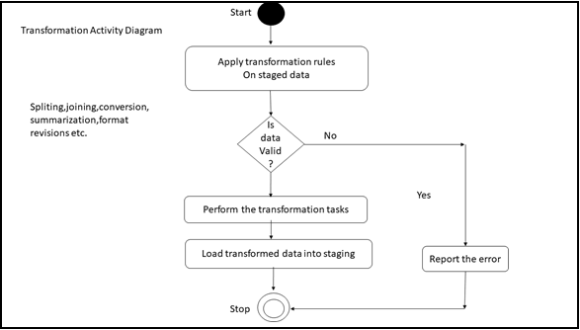
Activity Diagram (Transform)

Slide 13
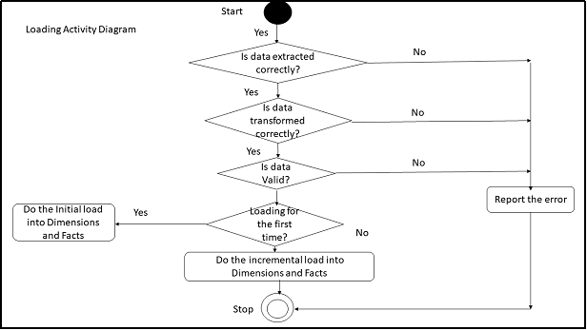
Activity Diagram (Load)

Slide 14
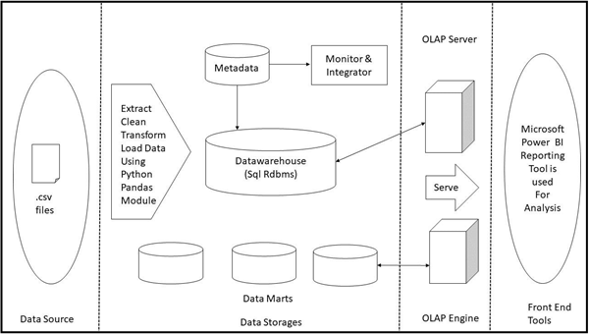
Design Of Target System

Slide 15
Table Specifications

Slide 16
Table 1
Field Name | Data Type
trip_id | int
start_time | datetime
end_time | datetime
bikeid | int
tripduration | time
from_station_id | int
from_staion_name | varchar(20)
to_station_id | int
to_station_name | varchar(20)
usertype | char(20)
gender | char(20)
birthyear | year
Chicago

Slide 17
Table 2
Field Name | Data Type
tripduration | time
starttime | datetime
stoptime | datetime
start station id | int
start station name | varchar(20)
start station latitude | float
start station longitude | float
end station id | int
end station name | varchar(20)
end station latitude | float
end station longitude | float
bikeid | int
usertype | char(20)
Birth year | year
gender | int
New York

Slide 18
Table 3
Field Name | Data Type
Duration | time
Start date | datetime
End date | datetime
Start station number | int
Washington DC
Start station | char(20)
End station number | int
End station | char(20)
Bike number | varchar(20)
Member Type | char(20)

Slide 19
Table 4
Field Name | Data Type
tripduration | time
starttime | datetime
stoptime | datetime
start station id | int
start station name | varchar(20)
start station latitude | float
start station longitude | float
end station id | int
end station name | varchar(20)
end station latitude | float
end station longitude | float
bikeid | int
usertype | char(20)
birth year | year
gender | int
New Jersey City

Slide 20
Table 5
Field Name | Data Type
tripduration | time
starttime | datetime
stoptime | datetime
start station id | int
start station name | varchar(20)
start station latitude | float
start station longitude | float
end station id | int
end station name | varchar(20)
end station latitude | float
end station longitude | float
bikeid | int
usertype | char(20)
birth year | year
gender | int
Boston

Slide 21
Technology
Operating System :- Windows 10 Professional
RDBMS :- MySQL
Language :- Python (Panda library for data ETL purpose)
BI Tool :- Microsoft Power BI for reporting purpose

Slide 22
Power BI Dashboard

Slide 23
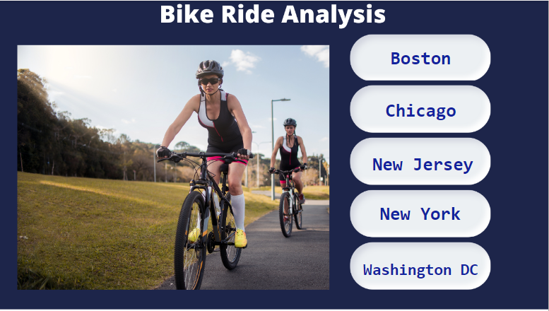

Slide 24
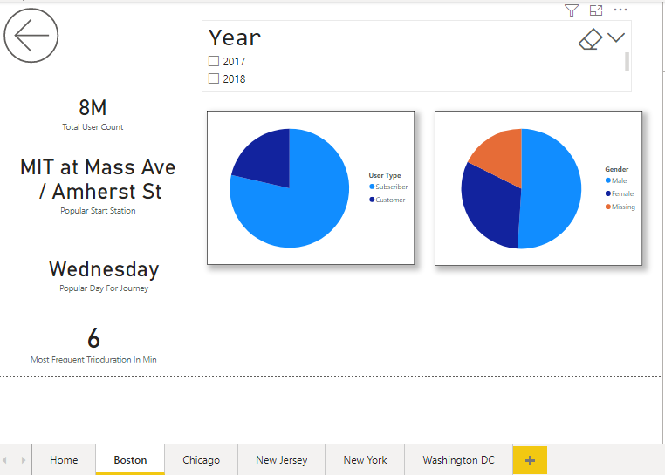

Slide 25
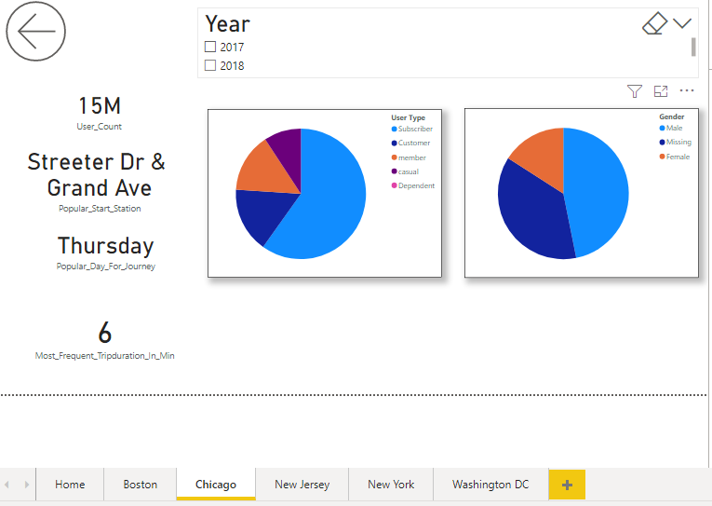

Slide 26
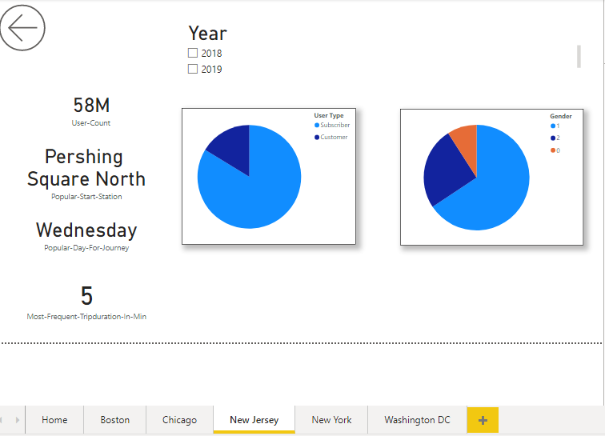

Slide 27
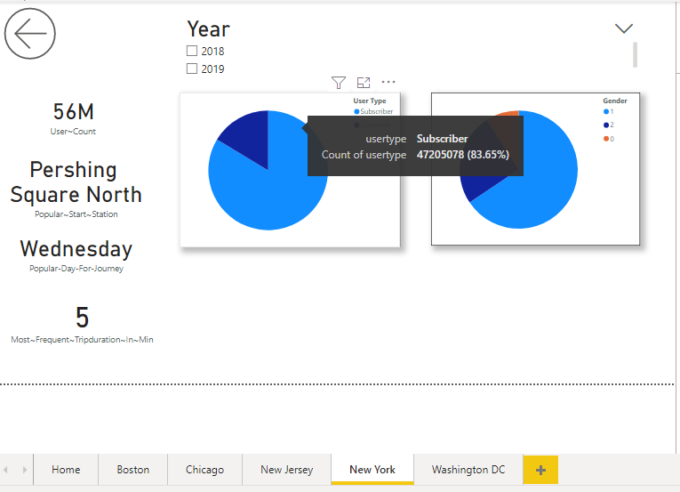

Slide 28
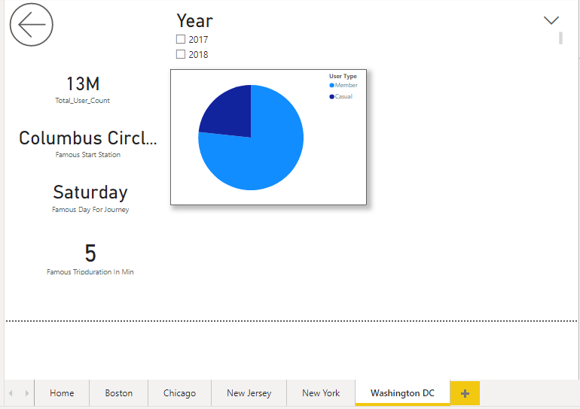

Slide 29
Thank You!

Slide 30
Q & A

